Slide 1
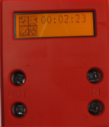
Article 67j) : BEV - Joulemeter Connections
Motor (s)
Solar Cells
Solar panel module (optional)
Max Power Controller (optional)
JM^{SOL}
JM^{MTR}
Motor Controller
Motor (s)
Lights, horn, other
accessories
Battery / Electrical System

